Slide 1
Demand Paging

Slide 2
Brief
With demand-paged virtual memory , pages are loaded only when they are demanded during program execution. Pages that are never accessed are thus never loaded into physical memory.
A demand-paging system is similar to a paging system with swapping where processes reside in secondary memory (usually a disk).
When we want to execute a process, we swap it into memory. Rather than swapping the entire process into memory, though, we use a lazy swapper.
A lazy swapper never swaps a page into memory unless that page will be needed. A swapper manipulates entire processes, whereas a pager is concerned with the individual pages of a process

Slide 3
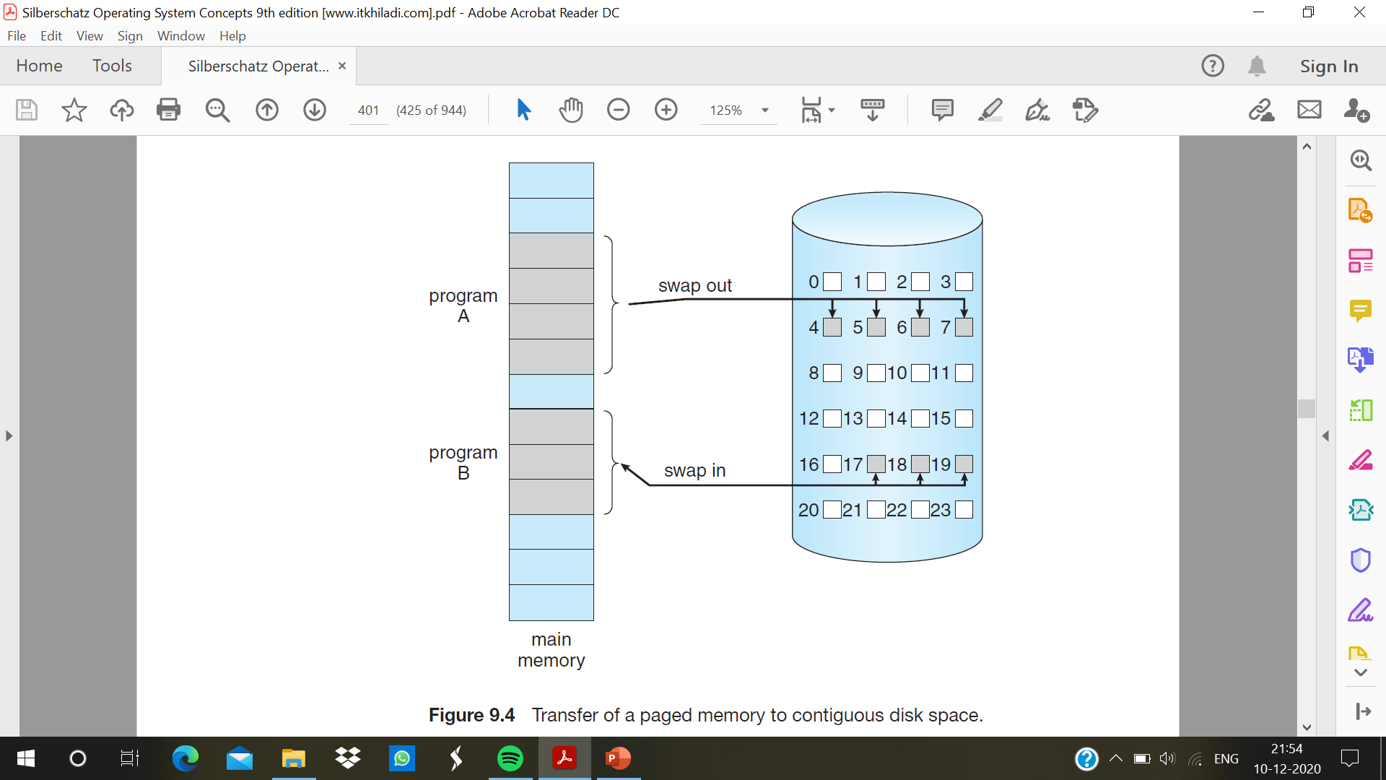

Slide 4
Basic concepts
When a process is to be swapped in, the pager guesses which pages will be used before the process is swapped out again. Instead of swapping in a whole process, the pager brings only those pages into memory. Thus, it avoids reading into memory pages that will not be used anyway, decreasing the swap time and the amount of physical memory needed.
valid–invalid bit scheme used for hardware support to distinguish between the pages that are in memory and the pages that are on the disk.
when this bit is set to “valid,” the associated page is both legal and in memory. If the bit is set to “invalid,” the page either is not valid (that is, not in the logical address space of the process) or is valid but is currently on the disk.
marking a page invalid will have no effect if the process never attempts to access that page. While the process executes and accesses pages that are memory resident, execution proceeds normally

Slide 5
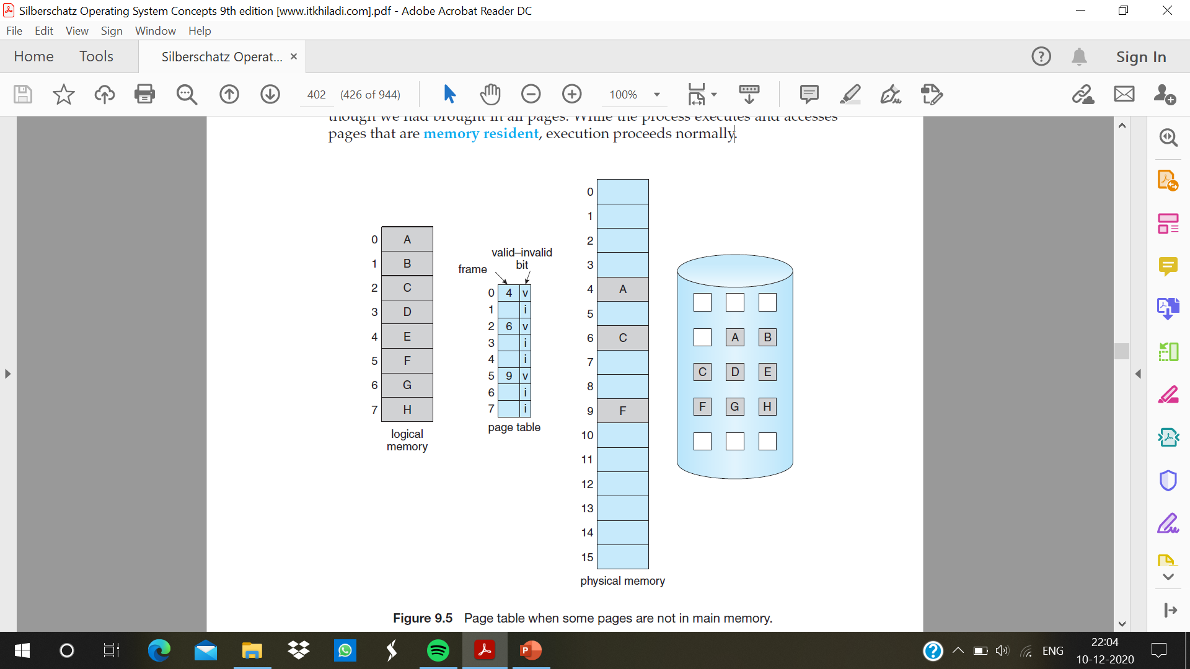

Slide 6
page fault
if the process tries to access a page that was not brought into memory. Access to a page marked invalid causes a page fault.
The paging hardware, in translating the address through the page table the invalid bit is set causing a trap to the operating system.
This trap is the result of the operating system’s failure to bring the desired page into memory

Slide 7
Handling page fault :
1. check an internal table (usually kept with the process control block) for this process to determine whether the reference was a valid or an invalid memory access.
2. If the reference was invalid, terminate the process. If it was valid but have not yet brought in that page, then page it in.
3. find a free frame.
4. schedule a disk operation to read the desired page into the newly allocated frame.
5. When the disk read is complete, modify the internal table kept with the process and the page table to indicate that the page is now in memory.
6. restart the instruction that was interrupted by the trap. The process can now access the page as though it had always been in memory

Slide 8
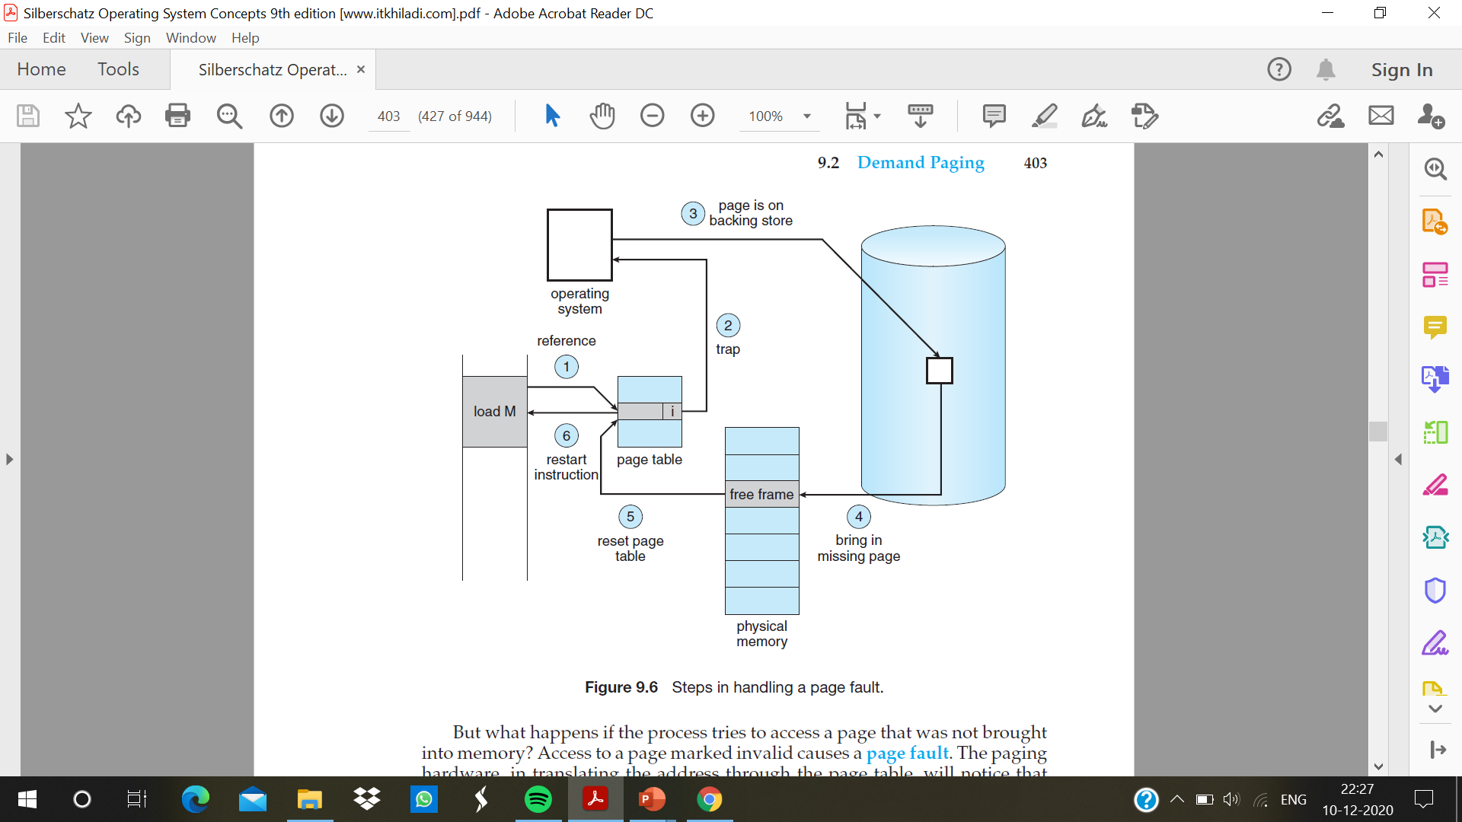

Slide 9
Pure Demand Paging
Executing a process with no pages in memory. When the operating system sets the instruction pointer to the first instruction of the process, which is on a non-memory-resident page, the process immediately faults for the page.
After this page is brought into memory, the process continues to execute, faulting as necessary until every page that it needs is in memory.
At that point, it can execute with no more faults. This scheme is pure demand paging: never bring a page into memory until it is required.
a given instruction could access multiple pages which results into multiple page faults and this Pain decreased because of locality of reference

Slide 10
The hardware to support demand paging
• Page table. This table has the ability to mark an entry invalid through a valid–invalid bit or a special value of protection bits.
• Secondary memory. This memory holds those pages that are not present in main memory. The secondary memory is usually a high-speed disk. It is known as the swap device, and the section of disk used for this purpose is known as swap space

Slide 11
Effective Access Time
Let p be the probability of a page fault (0 ≤ p ≤ 1) and the memory-access time denoted ma,
expect p to be close to zero—that is expect to have only a few page faults.
effective access time = (1 − p) × ma + p × page fault time

Slide 12
Stages of demand paging
1. Trap to the operating system.
2. Save the user registers and process state.
3. Determine that the interrupt was a page fault.
4. Check that the page reference was legal and determine the location of the page on the disk.
5. Issue a read from the disk to a free frame:
a. Wait in a queue for this device until the read request is serviced.
b. Wait for the device seek and/or latency time.
c. Begin the transfer of the page to a free frame.

Slide 13
6. While waiting, allocate the CPU to some other user (scheduling)
7. Receive an interrupt from the disk I/O subsystem (I/O completed).
8. Save the registers and process state for the other user .
9. Determine that the interrupt was from the disk.
10. Correct the page table and other tables to show that the desired page is now in memory.
11. Wait for the CPU to be allocated to this process again.
12. Restore the user registers, process state, and new page table, and then resume the interrupted instruction.

